Slide 1
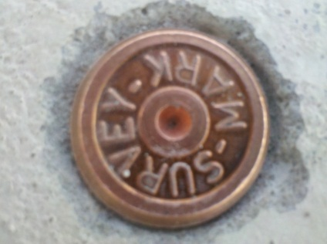
Bay 700 Pilot – update
D
Bay 700 Pilot – update
N
3D Pilot bay 700
We have completed the scanning process - approx. 100 scans - and working on registering and stitching – diluting and sectioning.
Looking for best program compatibility in order to achieve clear superposition of point cloud and pop-out design package.
CP- Project
CPs have been marked. We have decided to get as close to Fab true grids as possible.
The special drill bit has arrived and the mock-up has been done – the results are not perfect. Another mock-up drilling is planned for today after this meeting.
All Brass Caps will be installed next week.
We will conduct an as-built survey in order to get the accurate coordinates xyz for each CP. We will then be able to check at what accuracy the brass caps have been installed and collect accurate coordinates for each CP.
An excel sheet will be prepared with CP# / x / y / z for later use of scan tie in.
Naming convention: see illustration
D/3
E/3
CP-D3-S
CP-E3-N
CP-D3-W
CP-E3-W
CP-D4-E
CP-D4-E
4
D/4
CP-D4-S
CP-D4-N
D/4
Section D/3
Proposed naming convention

Slide 2
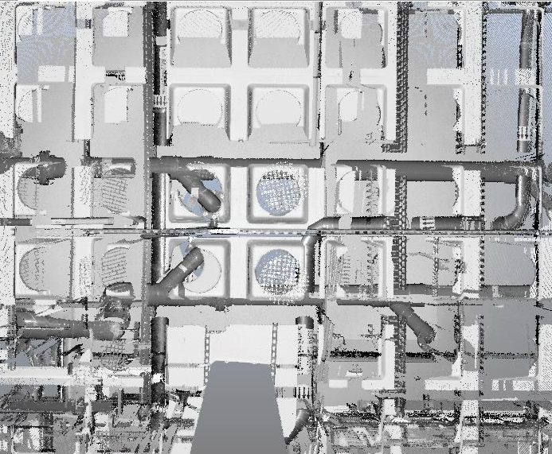


Slide 3
GST104/105 – AW pipe
Pipe Scanning Process for GST104/105
GST104 | GST105
8 scans done | 3 scans done
Used 6 scans: not connected – no spheres for stitching | Used 2 scans: not connected – no spheres for stitching
How we worked
Used 6 scans: not connected – no spheres for stitching
Sokkia survey using arrows on pipes as targets
Model of each scan and placement into coordinate system using Total Station coordinates.
Some areas could not be modeled because of lack of visibility.
Lessons Learned
Need placement of spheres for accurate stitching – result: One point cloud – Scene viewer – Easy modeling with Kubit to pipe dwg
Need possibility to view results during scanning session – Computer
Possibly work from CR down through Pop-outs
Tripods for spheres from below or installation through pop-out from CR
Intel Photo Permit?

Slide 4
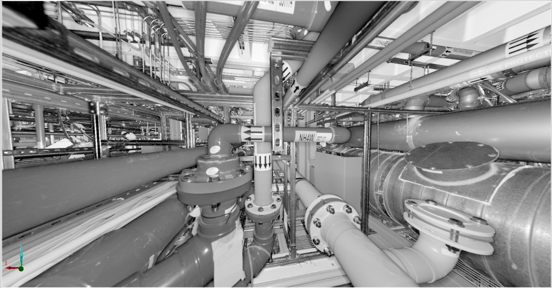
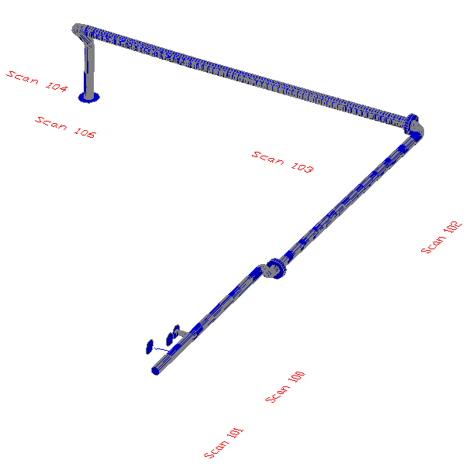
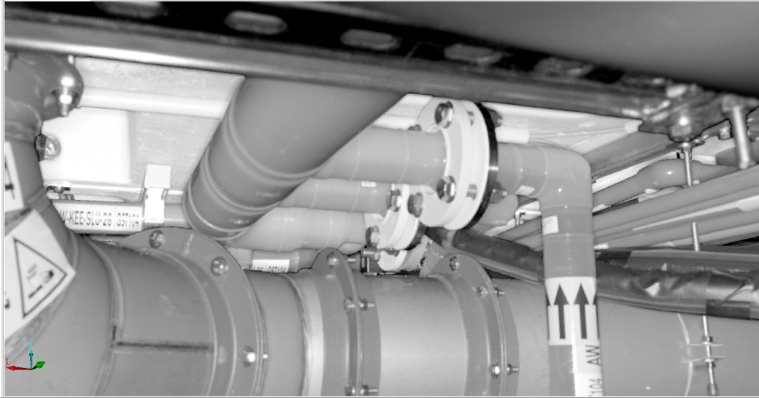
GST104 – AW pipe

Slide 5
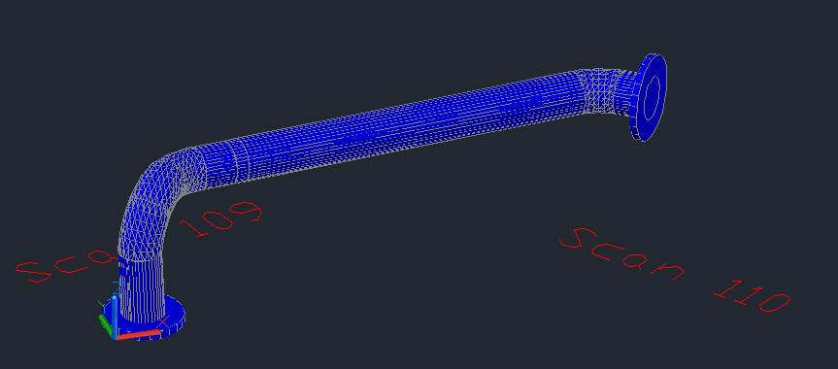
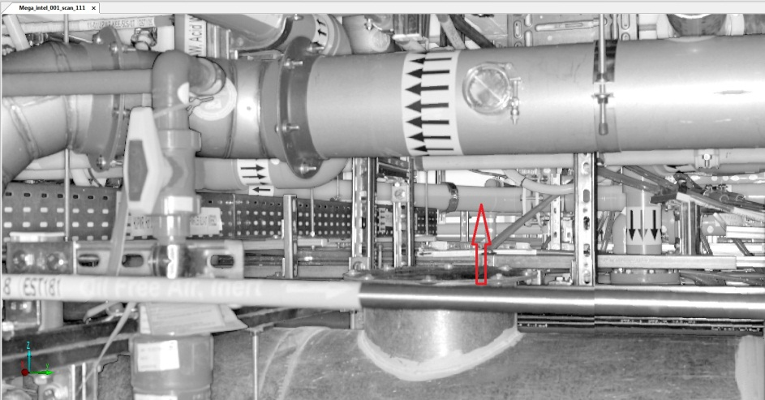
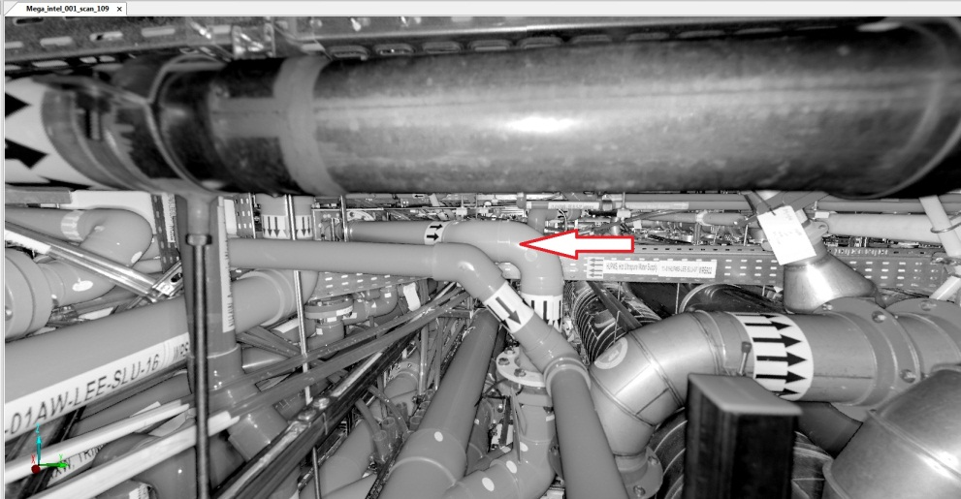
First 3D Pilot - 2012
Pipe Scanning Process for GST104/105
Scanning Stations

Slide 6
Choice of Programs
Programs
Scene – Viewer – comes with scanner – download at: http://www.faro.com/faro-3d-app-center/stand-alone-apps/scene-lt
Kubit - Point Sense Plant – From Point Cloud to AutoCad – needs to be purchased
http://www.youtube.com/watch?v=ziujvVRv4QA&list=PL7CF9DF4CDB7859F2
AutoCAD Plant 3D – Intel BIM room
Navisworks – Clash - Intel BIM room
Courses available for all programs

